Slide 1
PBS Focus: to engage with the content and take notes.
Title: Introduction to Equations
Aim:
Solve two step equations using the balancing method
Plan:
Daily review Order of operation (BIMDAS).
Daily review common mathematical terms involving equations.
Solving 2 step linear equations using balancing method.

Slide 2
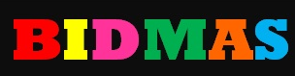


Slide 3
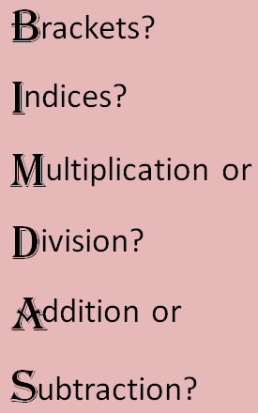
Doing calculations using BIMDAS
9 + 2 x 4
(8 - 3) x 5
= 9 + 8
= 5 x 5
= 17
= 25
(5 – 1)² x (5 - 3) ÷ 4
4 + 5 x 6 - 7
= 4² x 2 ÷ 4
Write
= 4 +
30
- 7
= 16 x 2 ÷ 4
Underline
= 27
= 8
Replace
Rewrite
8 x (3+7) - (35 - 3) ÷ 2³
= 8 x 10 - 32 ÷ 2³
= 8 x 10 - 32 ÷ 8
= 80 - 4
= 76

Slide 4
Doing calculations using BIMDAS
9 + 2 x 4
(8 - 3) x 5
4 + 5 x 6 - 7
(5 – 1)² x (5 - 3) ÷ 4
Write
Underline
Replace
Rewrite
8 x (3+7) - (35 - 3) ÷ 2³

Slide 5




Determine if the following equations are true
a) $6+5×2=2×10−4$
c) $15×8=4(8+7)$
b) $−3×4−6=−6+6×6$
d) $\frac{2(3+2)}{5}=\frac{6×4}{4}$

Slide 6

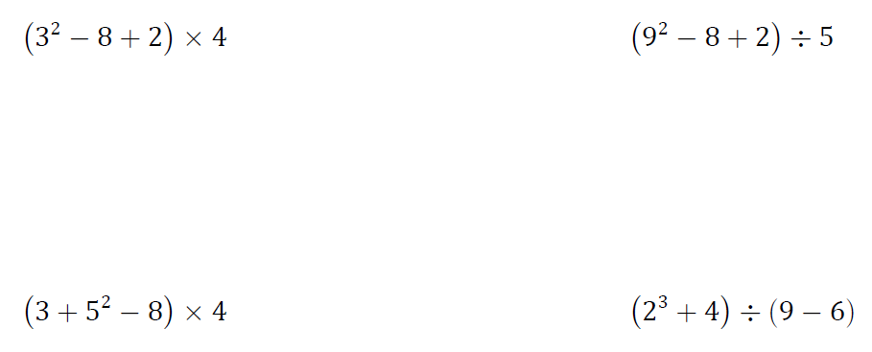
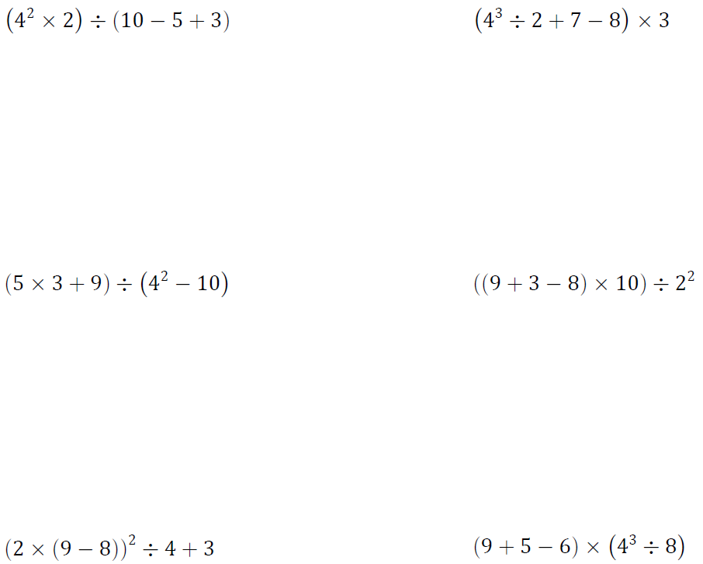



How do we work Forwards BIMDAS Practice 1
$$2+3×8$$
$$10−3^{2}$$
$$(9−5)×4$$

Slide 7
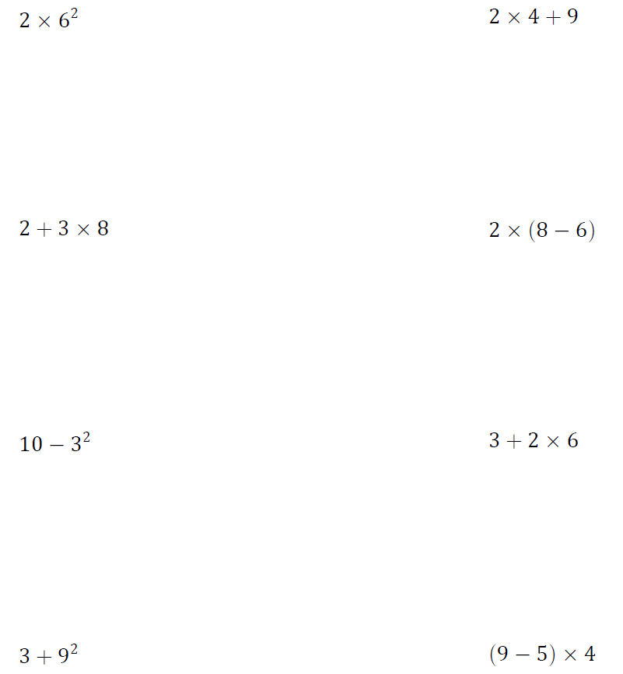
How do we work Forwards BIMDAS Practice 1
= 2 x 2
= 4
= 3 x 4
= 4 ÷ 4 + 3
= 12
= 4
= 2 + 24
= 26
= 12 ÷ 3
= 4
= 40 ÷ 4
= 10
= 10 - 9
= 20 x 4
= 1
= 80
= 24 ÷ 6
= 4 x 4
= 75 ÷ 5
= 16
= 4
= 15

Slide 8
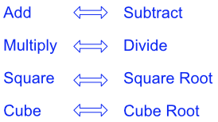
Inverse Operation

Slide 9
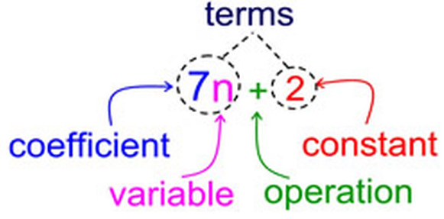
Constance are sometimes referred to as number terms

Slide 10
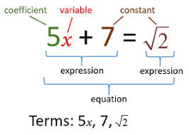
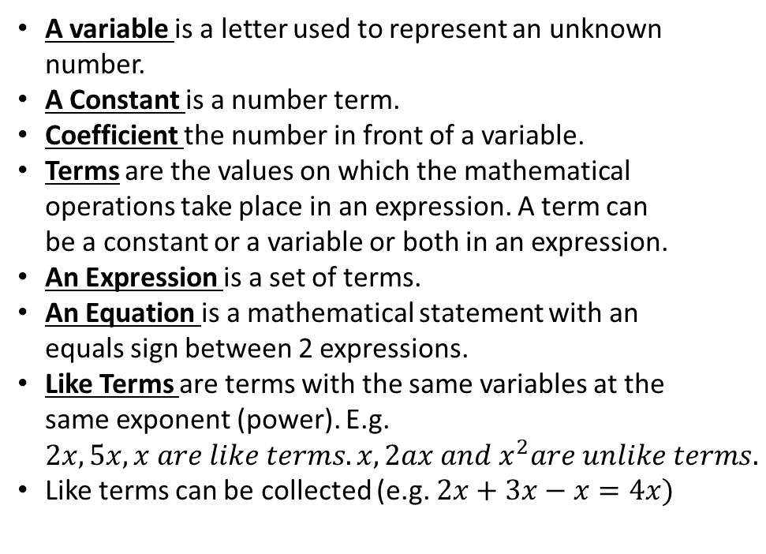
Reteach
A variable is a letter used to represent an unknown number.
A Constant is a number term.
Coefficient the number in front of a variable.
Terms are the values on which the mathematical operations take place in an expression. A term can be a constant or a variable or both in an expression.
An Expression is a set of terms.
An Equation is a mathematical statement with an equals sign between 2 expressions.
Like Terms are terms with the same variables at the same exponent (power). E.g. $2x, 5x, x are like terms. x, 2ax and x^{2}are unlike terms.$
Like terms can be collected (e.g. $2x+3x−x=4x)$

Slide 11
How to solve a linear equation;
Solving the equation means getting the variable by itself (preferably on the left hand side
To solve an equation you need to work backwards. Remember to ‘undo’ what has been done to the unknown value.
Always work downwards showing your working out as you go.
Keep going until you have got a value for the letter.

Slide 12
2x + 6 =32
‘undo’ the +6 by taking 6 away from 32
2x = 32-6
2x = 26
‘undo’ the multiply by 2 by dividing by 2
x = 26/2
X = 13
The unknown value is 13, check that this works 2 x 13 = 26
26 + 6 = 32

Slide 13
Year 7 review
Year 7 method
Year 8 method
3x + 7 = 19
8f + 2 = 26
3x + 7 = 19
8f + 2 = 26

Slide 14
Steps
“Undo” the constant by doing the opposite operation to both sides
“Undo” the coefficient by doing the opposite operation to both sides

Slide 15
Undo” the constant by doing the opposite operation to both sides
“Undo” the coefficient by doing the opposite operation to both sides
I do
We do
4c + 8 = 16
5f – 10 = 15
9d + 3 = 30
3d – 5 = 25

Slide 16

Try these equations;
3x + 5 = 35
7x – 4 = 80
$\frac{x}{3}$+ 1 = 4
24 – 5x = 9
62 = 7x + 6
185 = 4x – 15

Slide 17
Answers
3x + 5 = 35
7x – 4 = 80
x/3 + 1 = 4
24 – 5x = 9
62 = 7x + 6
185 = 4x – 15
x = 10
x = 12
x = 9
x = 3
x = 8
x = 50

Slide 18
Individual practice
Complete task sheet “What problem did the dumb gangster have when the boss told him to blow up a car?”

Slide 19
If the equation is more complicated;
Simplify the equation, collect like terms, if there are brackets multiply them out first.
If there is more then one unknown value on either side of the equals sign collect them together on one side and collect the numbers on the other.

Slide 20
2x + 4 = 3x - 2
Collect the x’s together, it is better to try and keep the x values positive.
Get rid of the 2x by subtracting it from both sides
2x-2x + 4 = 3x – 2x – 2
4 = x – 2
Collect the numbers together on the other side of the equals.
Get rid of the - 2 by adding 2 to both sides
4 + 2 = x - 2 + 2
6 = x

Slide 21
Try the following equations;
4x + 10 = 2x + 26
5x – 6 = 10x – 16
20x + 4 = 15x + 34
3(x + 1 ) = 15
2(3x + 2) + 3(x – 1) = 28

Slide 22
Answers
1) 4x + 10 = 2x + 26
2x +10 = 26
2x = 16
x=8
2) 5x – 6 = 10x – 16
- 6 = 5x -16
10 = 5x
2=x
3) 20x + 4 = 15x + 34
5x + 4 = 34
5x = 30
x = 6
4) 3(x + 1 ) = 15
3x + 3 = 15
3x = 12
x = 4
5) 2(3x + 2) + 3(x – 1) = 28
6x + 4 + 3x – 3 = 28
9x + 1 = 28
9x = 27
x = 3

